Slide 1
Graphs
Education is what remains after one has forgotten what one has learned in school. Albert Einstein
Smitha N Pai

Slide 2
Terminology and representations
Graph operations
Breadth first
depth first and level order traversal
spanning trees
minimum cost spanning tree
shortest path and transitive closure 6 hrs.
(6.1 – 6.4
Ellis Horowitz, Sartaj Sahni , Anderson, “ Fundamentals of Data Structures in C”, Silicon Press, 2nd Edition, 2007.)

Slide 3
Konigsberg Bridge Problem
A river Pregel flows around the island Keniphof and then divides into two.
Four land areas A, B, C, D have this river on their borders.
The four lands are connected by 7 bridges a – g.
Determine whether it’s possible to walk across all the bridges exactly once in returning back to the starting land area.

Slide 4
Konigsberg Bridge Problem (Cont.)
c
C
d
g
A
Kneiphof
e
D
C
f
g
a
B
c
d
b
e
A
D
a
b
f
B

Slide 5
Euler’s Graph
Define the degree of a vertex to be the number of edges incident to it
Euler showed that there is a walk starting at any vertex, going through each edge exactly once and terminating at the start vertex iff the degree of each vertex is even. This walk is called Eulerian.
No Eulerian walk of the Konigsberg bridge problem since all four vertices are of odd edges.

Slide 6
Definition of A Graph
A graph, G, consists of two sets, V and E.
V is a finite, nonempty set of vertices.
E is set of pairs of vertices called edges.
The vertices of a graph G can be represented as V(G).
Likewise, the edges of a graph, G, can be represented as E(G).
Graphs can be either undirected graphs or directed graphs.
For a undirected graph, a pair of vertices (u, v) or (v, u) represent the same edge.
For a directed graph, a directed pair <u, v> has u as the tail and the v as the head. Therefore, <u, v> and <v, u> represent different edges.

Slide 7
Three Sample Graphs
0
0
0
1
2
1
2
1
3
3
4
5
6
2
V(G₁) = {0, 1, 2, 3}
V(G₂) = {0, 1, 2, 3, 4, 5, 6}
V(G₃) = {0, 1, 2}
E(G₁) = {(0, 1), (0, 2), (0, 3), (1, 2), (1, 3), (2, 3)}
E(G₂) = {(0, 1), (0, 2), (1, 3), (1, 4), (2, 5), (2, 6)}
E(G₃) = {<0, 1>, <1, 0>, <1, 2>}
(a) G₁
(b) G₂
(c) G₃

Slide 8
Graph Restrictions
A graph may not have an edge from a vertex back to itself.
(v, v) or <v, v> are called self edge or self loop. If a graph with self edges, it is called a graph with self edges.
A graph may not have multiple occurrences of the same edge.
If without this restriction, it is called a multigraph.

Slide 9
Complete Graph
The number of distinct unordered pairs (u, v) with u≠v in a graph with n vertices is n(n-1)/2.
A complete unordered graph is an unordered graph with exactly n(n-1)/2 edges.
A complete directed graph is a directed graph with exactly n(n-1) edges.

Slide 10
Three Sample Graphs
0
0
0
1
2
1
2
1
3
3
4
5
6
2
V(G₁) = {0, 1, 2, 3}
V(G₂) = {0, 1, 2, 3, 4, 5, 6}
V(G₃) = {0, 1, 2}
E(G₁) = {(0, 1), (0, 2), (0, 3), (1, 2), (1, 3), (2, 3)}
E(G₂) = {(0, 1), (0, 2), (1, 3), (1, 4), (2, 5), (2, 6)}
E(G₃) = {<0, 1>, <1, 0>, <1, 2>}
(a) G₁
(b) G₂
(c) G₃

Slide 11
Examples of Graphlike Structures
0
0
1
1
3
2
2
(a) Graph with a self edge
(b) Multigraph

Slide 12
Graph Edges
If (u, v) is an edge in E(G), vertices u and v are adjacent and the edge (u, v) is the incident on vertices u and v.
For a directed graph, <u, v> indicates u is adjacent to v and v is adjacent from u.

Slide 13
Subgraph and Path
Subgraph: A subgraph of G is a graph G’ such that V(G’) V(G) and E(G’) E(G).
Path: A path from vertex u to vertex v in graph G is a sequence of vertices u, i₁, i₂, …, i_{k}, v, such that (u, i₁), (i₁, i₂), …, (i_{k}, v) are edges in E(G).
The length of a path is the number of edges on it.
A simple path is a path in which all vertices except possibly the first and last are distinct.
A path (0, 1), (1, 3), (3, 2) can be written as 0, 1, 3, 2.
Cycle: A cycle is a simple path in which the first and last vertices are the same.
Similar definitions of path and cycle can be applied to directed graphs.

Slide 14
G₁ and G₃ Subgraphs
0
0
0
1
2
1
2
1
2
3
(i)
(ii)
(iii)
(iv)
3
(a) Some subgraphs of G₁
0
0
0
0
1
1
1
(i)
(ii)
2
2
2
(a) Some subgraphs of G₃
(iii)
(iv)

Slide 15
Connected Graph
Two vertices u and v are connected in an undirected graph iff there is a path from u to v (and v to u).
An undirected graph is connected iff for every pair of distinct vertices u and v in V(G) there is a path from u to v in G.
A connected component of an undirected is a maximal connected subgraph.
A tree is a connected acyclic graph.

Slide 16
Strongly Connected Graph
A directed graph G is strongly connected iff for every pair of distinct vertices u and v in V(G), there is directed path from u to v and also from v to u.
A strongly connected component is a maximal subgraph that is strongly connected.

Slide 17
Graphs with Two Connected Components
H₁
H₂
0
0
1
2
1
2
3
3
G₄

Slide 18
Strongly Connected Components of G₃
0
1
2

Slide 19
Degree of A Vertex
Degree of a vertex: The degree of a vertex is the number of edges incident to that vertex.
If G is a directed graph, then we define
in-degree of a vertex: is the number of edges for which vertex is the head.
out-degree of a vertex: is the number of edges for which the vertex is the tail.
For a graph G with n vertices and e edges, if d_{i} is the degree of a vertex i in G, then the number of edges of G is

Slide 20
Abstract of Data Type Graphs
class Graph
{
// objects: A nonempty set of vertices and a set of undirected edges
// where each edge is a pair of vertices
public:
Graph(); // Create an empty graph
void InsertVertex(Vertex v);
void InsertEdge(Vertex u, Vertex v);
void DeleteVertex(Vertex v);
void DeleteEdge(Vertex u, Vertex v);
Boolean IsEmpty(); // if graph has no vertices return TRUE
List<List> Adjacent(Vertex v);
// return a list of all vertices that are adjacent to v
};

Slide 21
Adjacent Matrix
Let G(V, E) be a graph with n vertices, n ≥ 1. The adjacency matrix of G is a two-dimensional nxn array, A.
A[i][j] = 1 iff the edge (i, j) is in E(G).
The adjacency matrix for a undirected graph is symmetric, it may not be the case for a directed graph.
For an undirected graph the degree of any vertex i is its row sum.
For a directed graph, the row sum is the out-degree and the column sum is the in-degree.

Slide 22
Adjacency Matrices
(a) G₁
(b) G₃
(c) G₄

Slide 23
Adjacency Lists
Instead of using a matrix to represent the adjacency of a graph, we can use n linked lists to represent the n rows of the adjacency matrix.
Each node in the linked list contains two fields: data and link.
data: contain the indices of vertices adjacent to a vertex i.
Each list has a head node.
For an undirected graph with n vertices and e edges, we need n head nodes and 2e list nodes.
The degree of any vertex may be determined by counting the number nodes in its adjacency list.
The number of edges in G can be determined in O(n + e).
For a directed graph (also called digraph),
the out-degree of any vertex can be determined by counting the number of nodes in its adjacency list.
the in-degree of any vertex can be obtained by keeping another set of lists called inverse adjacency lists.

Slide 24
Adjacent Lists
HeadNodes
[0]
3
1
2
0
[1]
2
3
0
0
[2]
1
3
0
0
[3]
0
1
2
0
(a) G₁
HeadNodes
[0]
1
0
[1]
2
0
0
[2]
0
(b) G₃

Slide 25
Adjacent Lists (Cont.)
HeadNodes
[0]
2
1
0
[1]
3
0
0
[2]
0
3
0
[3]
1
1
0
[4]
5
0
[5]
6
4
0
[6]
5
7
0
[7]
6
0
(c) G₄

Slide 26
Weighted Edges
Very often the edges of a graph have weights associated with them.
distance from one vertex to another
cost of going from one vertex to an adjacent vertex.
To represent weight, we need additional field, weight, in each entry.
A graph with weighted edges is called a network.

Slide 27
Graph Operations
A general operation on a graph G is to visit all vertices in G that are reachable from a vertex v.
Depth-first search
Breath-first search

Slide 28
Depth-First Search
Starting from vertex v, an unvisited vertex w adjacent to v is selected and a depth-first search from w is initiated.
When the search operation has reached a vertex u such that all its adjacent vertices have been visited, we back up to the last vertex visited that has an unvisited vertex w adjacent to it and initiate a depth-first search from w again.
The above process repeats until no unvisited vertex can be reached from any of the visited vertices.

Slide 29
Graph G and Its Adjacency Lists
0
1
2
3
4
5
6
HeadNodes
[0]
1
2
0
7
[1]
0
3
4
0
[2]
0
5
6
0
[3]
1
7
0
[4]
1
7
0
o/p: 0,1,3,7,4,5,2,6
[5]
2
7
0
[6]
2
7
0
[7
3
4
5
6
0

Slide 30
DFS Algorithm
/*Given an undirected graph G = (V,E) with n vertices and an array VlSlTED(n) initially set to False, this algorithm visits all vertices reachable from v. G and VISITED are global.*/
int Visited[]
Algorithm DFS(v)
{
VISITED[v] = True
for each vertex w adjacent to v do
if VISlTED[w] =False then
call DFS(w)
}

Slide 31
Analysis of DFS
If G is represented by its adjacency lists, the DFS time complexity is O(e).
If G is represented by its adjacency matrix, then the time complexity to complete DFS is O(n²).

Slide 32
Breath-First Search
Starting from a vertex v, visit all unvisited vertices adjacent to vertex v.
Unvisited vertices adjacent to these newly visited vertices are then visited, and so on.
If an adjacency matrix is used, the BFS complexity is O(n²).
If adjacency lists are used, the time complexity of BFS is O(e).
o/p: 0,1,2,3,4,5,6,7

Slide 34
Spanning Tree
Any tree consisting solely of edges in G and including all vertices in G is called a spanning tree.
Spanning tree can be obtained by using either a depth-first or a breath-first search.
When a nontree edge (v, w) is introduced into any spanning tree T, a cycle is formed.
A spanning tree is a minimal subgraph, G’, of G such that V(G’) = V(G), and G’ is connected. (Minimal subgraph is defined as one with the fewest number of edges).
Any connected graph with n vertices must have at least n-1 edges, and all connected graphs with n – 1 edges are trees. Therefore, a spanning tree has n – 1 edges.

Slide 35
A Complete Graph and Three of Its Spanning Trees

Slide 36
Spanning trees
A spanning tree is any tree that consists solely of edges in G and that includes all the vertices in G
With dfs the resulting spanning tree is known as depth first spanning tree
With bfs – breadth first spanning tree

Slide 37
Minimum cost spanning tree
The cost of the spanning tree of a weighted undirected graph is the sum of the costs of the edges in the spanning tree.
A minimum cost spanning tree is a spanning tree of least cost
Solution
Use only the edges within the graph
Use exactly n-1 edges
Use edges that do not a produce a cycle.

Slide 38
Kruskal’s algorithm
T={}
While ( T contains less than n-1 edges && E is not empty)
{
choose a least cost edge (v,w) from E;
delete (v,w ) from E
If ((v,w) does not create a cycle in T)
Add (v,w) to T;
Else
Discard (v,w)
}
If ( T contains fewer than n-1 edges)
Printf(“No spanning tree\n”);

Slide 39
Prim’s algorithm
T={};
TV={0};
While ( T contains less than n-1 edges)
{
let (u,v) be a least cost edge such that u ϵ TV and v does not ϵ to TV;
If (there is no such edge )
break;
Add v to TV;
Add (u,v) to T;
}
If ( T contains fewer than n-1 edges)
Printf(“No spanning tree\n”);

Slide 40
Shortest path
Single source all destination –Djikstra’s algorithm

Slide 41
All pairs shortest path
Generate matrices A⁰ , A¹ ,A² ,A³ ,A^{n-1}
If A^{k-1} is generated then A^{k} is realized for any pair of vertices i,j using the two rules:
The shortest path from i to j going through no vertex with index greater than k does not go through the vertex with index k and so its costs is A^{k-1} [i][j]
The shortest such path does go through vertex k. Such a path consists of a path from i to k followed by one from k to j. Neither of these goes through a vertex with index greater than k-1. Hence, their costs are A^{k-1} [i][k] and A^{k-1} [k][j].
These rules yield the following formula for A^{k} [i][j]
A^{k}[i][j] =min {A^{k-1} [i][j], A^{k-1} [i][k] + A^{k-1} [k][j]} where k≥0
A⁻¹[i][j]=cost[i][j]

Slide 42
Transitive closure
The transitive closure matrix, denoted A⁺ of a directed graph G is a matrix such that A⁺[i][j]=1 if there is a path of length >0 form i to j otherwise A⁺[i][j]=0
Reflexive transitive closure matrix closure matrix denoted A* of directed graph G is a maxtrix such that A*[i][j]=1 if there is a path of length≥0 from i to j, otherwise A*[i][j]=0
Modify the all pair shortest algorithm by changing the if statement in the nested for loop
distance[i][j]=distance[i][j] | | distance[i][k] &&distance[k][j]

Slide 43
Graphs
It consists of a set of nodes V(G)={a,b,..} and set of arcs {(a,b),(b,c)…}
Each arc/edge is specified by a pair of nodes
E(G)= {(a,b),(a,c)….}
If the pairs of nodes that make up the arcs are ordered pairs, the graph is said to be directed graph(digraph)
Arrows between nodes represent arcs
The head of each arrow represents the second node in the ordered pair of nodes making up an arc and tail represents the first node in the pair <a,b>

Slide 44
Graph Restrictions
A graph may not have an edge from a vertex back to itself.
(v, v) or <v, v> are called self edge or self loop. If a graph with self edges, it is called a graph with self loops.
A graph may not have multiple occurrences of the same edge.
If without this restriction, it is called a multigraph.

Slide 45
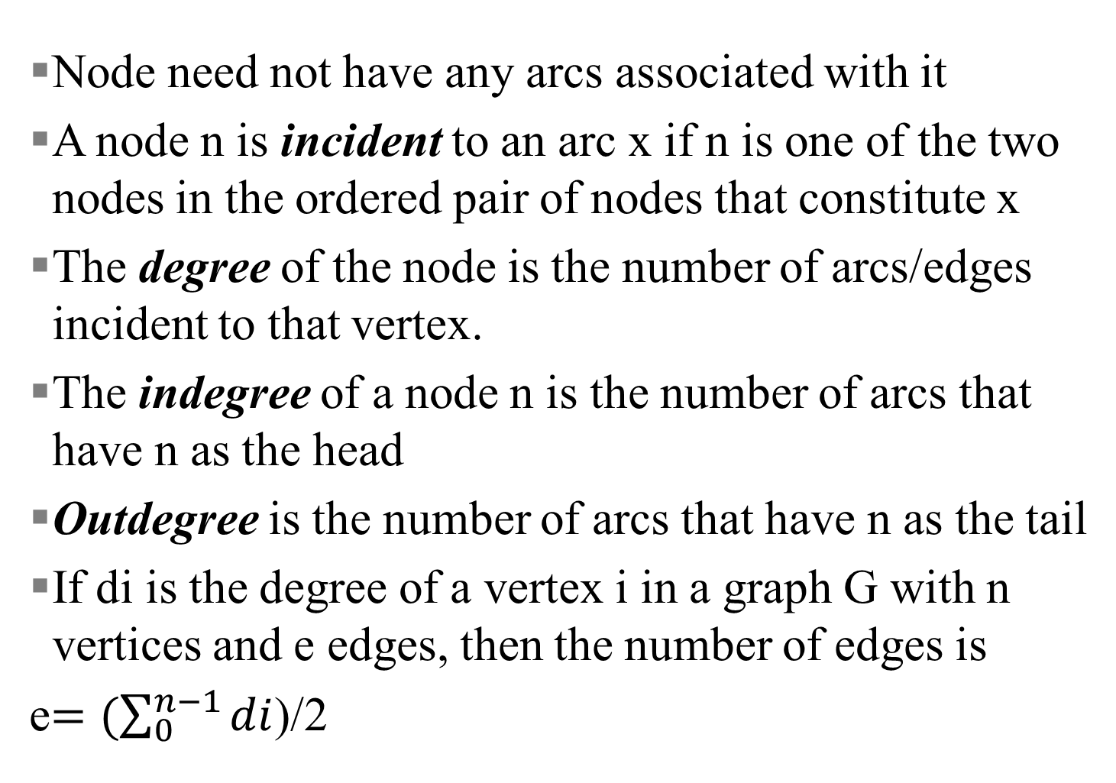
Graphs(contd.)
Node need not have any arcs associated with it
A node n is incident to an arc x if n is one of the two nodes in the ordered pair of nodes that constitute x
The degree of the node is the number of arcs/edges incident to that vertex.
The indegree of a node n is the number of arcs that have n as the head
Outdegree is the number of arcs that have n as the tail
If di is the degree of a vertex i in a graph G with n vertices and e edges, then the number of edges is
e$=(\sum_{0}^{n−1}{di}$)/2

Slide 46
Definition of A Graph
A graph, G, consists of two sets, V and E.
V is a finite, nonempty set of vertices.
E is set of pairs of vertices called edges.
The vertices of a graph G can be represented as V(G).
Likewise, the edges of a graph, G, can be represented as E(G).
Graphs can be either undirected graphs or directed graphs.
For a undirected graph, a pair of vertices (u, v) or (v, u) represent the same edge.
For a directed graph, a directed pair <u, v> has u as the tail and the v as the head. Therefore, <u, v> and <v, u> represent different edges.

Slide 47
Graphs
A node n is adjacent to a node m if there is an arc from m to n.
If n is adjacent to m, n is called a successor of m, and m a predecessor of n
A relation R on a set A is a set of ordered pairs of elements of A
If <x,y> is a member of a relation R, x is said to be related to y in R.
Relation may be represented by a graph in which the nodes represent the set and the arcs represent the ordered pairs of the relation

Slide 48
Graphs(contd).
A number associated with each arc is called the weighted graph or a network.
Number associated with an arc is called its weight
A path of length k from from a node a to node b is defined as a sequence of k+1 nodes n₁, n₂..n_{k+1} such that n₁= a, n_{k+1}=b and adjacent (n_{i},n_{i+1}) is true for all i between 1 and k
If for some integer k, a path of length k exists between a and b there is a path from a to b
A path from a node to itself is called a cycle
If a graph contains a cycle, it is cyclic; else acyclic
Directed acyclic graph is called a dag

Slide 49
Graphs(contd).
A complete graph is a graph that has maximum number of edges
For an undirected graph of n vertices, the maximum number of edges is the number of distinct, ordered pairs (vi, vj), i≠j
n(n-1)/2
For a directed graph of n vertices the maximum number of edges is n(n-1)

Slide 50
Graphs(contd).
A simple path is a path in which all the vertices except possibly the first and the last are distinct.
A cycle is a simple path in which the first and the last verices are the same
In undirected graph two vertices v0 and v1are connected if there is a path from one v0 to v1 , also a path from v1 to v0
An undirected graph is connected if, for every pair of distinct vertices vi, vj there is a path from vi to vj in G.
Tree is a graph which is connected and acyclic
Graph need not be a tree but a tree must be a graph

Slide 51
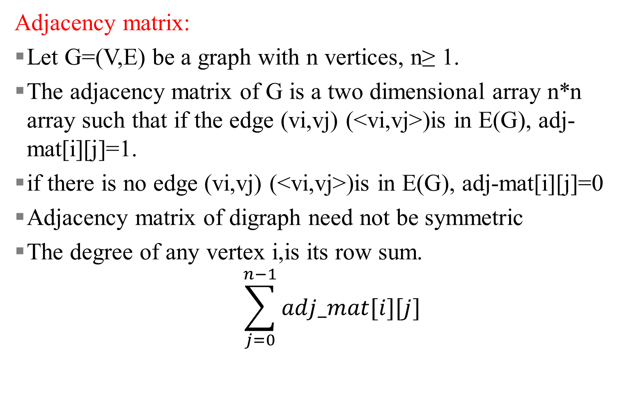
Graph representations
Adjacency matrix:
Let G=(V,E) be a graph with n vertices, n≥ 1.
The adjacency matrix of G is a two dimensional array n*n array such that if the edge (vi,vj) (<vi,vj>)is in E(G), adj-mat[i][j]=1.
if there is no edge (vi,vj) (<vi,vj>)is in E(G), adj-mat[i][j]=0
Adjacency matrix of digraph need not be symmetric
The degree of any vertex i,is its row sum.
$$\sum_{j=0}^{n−1}{adj_mat[i][j]}$$

Slide 52
Graph representations
Adjacency list:
Let G=(V,E) be a graph with n vertices, n≥ 1.
The number of heads is n and 2e list nodes
Each list node has two field

